Slide 1
Regular Expressions
Lecture #2
22 January 2018

Slide 2
News article
What was your news article about?

Slide 3
Rule-based vs Statistical Approaches to NLP
Rule-based = linguistic
Statistical = “learn” from a large corpus that has been marked up with the phenomena you are studying (Machine Learning)
For what problems is rule-based better suited and when is statistical better?
  Depends on the problem
    (e.g. classification/categorization problem)
  Depends on your resources
    (e.g. how much good training data is available)
Even when using statistical – many tasks easily done with rules: tokenization, sentence breaking, morphology
Some PARTS of a task may be done with rules: e.g., rules may be used to extract features, and then statistical learning methods might combine those features to perform a task.

Slide 4
Today we are going to …
Review Regular Expressions
  Allows one to capture patterns in text to develop rule based methods or use to collect features for stochastic methods (machine learning; statistical methods)
  There is an old joke:
    Some people, when confronted with a problem, think
    “I know, I'll use regular expressions.”
    Now they have two problems. – Jamie Zawinski
  Regular Expressions are handy and allow us to create complex rules to capture patterns in text

Slide 5
Regular Expressions
Can be viewed as a way to specify:
  Search patterns over text string
  Design of a particular kind of machine, called a Finite State Automaton (FSA)
These are really equivalent

Slide 6
Uses of Regular Expressions in NLP
As grep, perl: Simple but powerful tools for large corpus analysis and ‘shallow’ processing
  What word is most likely to begin a sentence?
  What word is most likely to begin a question?
  In your own email, are you more or less polite than the people you correspond with?
With other unix tools, allow us to
  Obtain word frequency and co-occurrence statistics
  Build simple interactive applications (e.g., Eliza)
Regular expressions define regular languages or sets

Slide 7
Regular Expressions
Simple but powerful tools for “shallow” processing of a document of “corpus”
  What word begins a sentence?
  What words begin a question
  Identify all NPs
These simple tools can enable us to
  Build simple interactive applications (e.g., Eliza)
  Recognize date, time, money… expressions
  Recognize Named Entities (NE): people names, company names
  Do morphological analysis

Slide 8
Some definitions
Regular Expression: Formula in algebraic notation for specifying a set of strings
String: Any sequence of alphanumeric characters
  Letters, numbers, spaces, tabs, punctuation marks
Regular Expression Search
  Pattern: specifying the set of strings we want to search for
  Corpus: the texts we want to search through

Slide 9
Simple Example
Sequence of simple characters:
RE | DESCRIPTION | USES
/This/ | Matches the string “This” | Finding the word “this” starting a sentence
/this/ | Matches the string “this” | Finding the word “this” internal to a sentence.
/[Tt]his/ | Matches either “This” or “this” -- disjunction | Finding the word “this” anywhere in a sentence.
Notes:
Note the // are part of perl – not part of the regular expression. – also assuming pattern is going to return an entire string.

Slide 10
Question?
What would my regular expression look like if I wanted to only match:
        Temperature
        and
        TeMPerature

Slide 11
Answer
Te(MP|mp)erature

Slide 12
Some regexes
Regex | Description
/./ | Wild card; any character
/\./ | Period
/a/ | Any ‘a’
/[ab]/ | Any a or b (choice)
/[a-z]/ | Any lowercase character (range)
/[A-Z]/ | Any upper case character (range)
/[^?.!]/ | Any non ?, . or ! (negation of set)
/\s/ | White space

Slide 13
More regexes
Regex | Example | Description
* | /a*/ | Zero or more a’s
+ | /a+/ | One or more a’s
? | /a?/ | Zero or one a
| | /cat|dog/ | The strings cat or dog
\b | /\bthe\b/ | The word ‘the’
\B | \bun\B | Words prefixed by ‘un’; Beginning of a longer string
\1 | \(again) and \1/ | Using string captured by () in regex
$ | /end of the line.$/ | Denotes end of a string
^ | /^First word/ | Denotes beginning of a string

Slide 14
Question
What is the regex to identify all the word dog and its plural form?

Slide 15
Answer
/\bdogs?\b/

Slide 16
Question
What is the regex to identify the word puppy and its plural form?

Slide 17
Answer
/\bpupp(y|ies)\b/

Slide 18
Question
What is the regex to identify all words that begin with no, or non, nonn, nonnn, etc. regardless of the n’s?

Slide 19
Answer
/\bnon*\B/

Slide 20
Question
What is the regular expression to identify ier and ier phrases such as:
happier and happier
Or
fuzzier and fuzzier

Slide 21
Answer
/(.+)ier and \1ier/
the \1 here is what ever was identified in the (.+)

Slide 22
Optionality and Repetition
/[Ww]oodchucks?/ matches woodchucks, Woodchucks, woodchuck, Woodchuck
/colou?r/ matches color or colour
/he{3}/ matches heee
/(he){3}/ matches hehehe
/(he){3,} matches a sequence of at least 3 he’s

Slide 23
Operator Precedence Hierarchy
1. Parentheses ()
2. Counters * + ? {}
3. Sequence of Anchors the ^my end$
4. Disjunction |
    /tr(y|ies)/
    -> bonus: what is \1?
    /^\s*$/
    -> what is this finding?

Slide 24
A Simple Exercise
Write a regular expression to find all instances of the determiner “the”:
      /the/
      /[tT]he/
      /\b[tT]he\b/
      /(^|[^a-zA-Z][tT]he[^a-zA-Z]/
The recent attempt by the police to retain their current rates of pay has not gathered much favor with the southern factions.

Slide 25
A Simple Exercise
Write a regular expression to find all instances of the determiner “the”:
      /the/
      /[tT]he/
      /\b[tT]he\b/
      /(^|[^a-zA-Z][tT]he[^a-zA-Z]/
The recent attempt by the police to retain their current rates of pay has not gathered much favor with the southern factions.

Slide 26
A Simple Exercise
Write a regular expression to find all instances of the determiner “the”:
      /the/
      /[tT]he/
      /\b[tT]he\b/
      /(^|[^a-zA-Z][tT]he[^a-zA-Z]/
The recent attempt by the police to retain their current rates of pay has not gathered much favor with the southern factions.

Slide 27
A Simple Exercise
Write a regular expression to find all instances of the determiner “the”:
      /the/
      /\bthe\b/
      /\b[tT]he\b/
      /(^|[^a-zA-Z][tT]he[^a-zA-Z]/
The recent attempt by the police to retain their current rates of pay has not gathered much favor with the southern factions.
Notes:
Looking good?

Slide 28
A Simple Exercise
Write a regular expression to find all instances of the determiner “the”:
      /the/
      /\bthe\b/
      /\b[tT]he\b/
      /(^|[^a-zA-Z][tT]he[^a-zA-Z]/
The recent attempt by the police to retain their current rates of pay has not gathered much favor with the southern factions.

Slide 29
A Simple Exercise
Write a regular expression to find all instances of the determiner “the”:
      /the/
      /[tT]he/
      /\b[tT]he\b/
      /(^|[^a-zA-Z][tT]he[^a-zA-Z]/
The recent attempt by the police to retain their current rates of pay has not gathered much favor with the southern factions.

Slide 30
A Simple Exercise
Write a regular expression to find all instances of the determiner “the”:
      /the/
      /[tT]he/
      /\b[tT]he\b/
      /(^|[^a-zA-Z][tT]he[^a-zA-Z]/
The recent attempt by the police to retain their current rates of pay has not gathered much favor with the southern factions.

Slide 31
Substitutions (Transductions)
Sed or ‘s’ operator in Perl
  s/regexp1/pattern/
  s/I am feeling (.+)/You are feeling \1?/
    I am feeling hungry -> You are feeling hungry?
  s/I gave (.+) to (.+)/Why would you give \2 \1?/
    I gave the money to Brad -> Why would you give Brad money?

Slide 32
How does this all relate to language processing?
aka why are regexes useful?
  What do you do when you want to process each sentence in a paragraph individually and want it done quickly because you are receiving a new paragraph every second?
  What happens if you want to obtain the number of times immunosuppression occurred in the text?

Slide 33
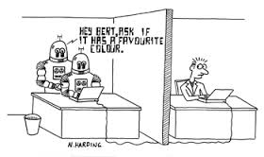
Computing Machinery and Intelligence
Alan Turing
  1950: published Computing Machinery and Intelligence
  Asked the question: how do we determine if a computer is intelligent
  Proposed solution: develop
  a computer program to
  impersonate a human
  in a real-time written
  conversation

Slide 34
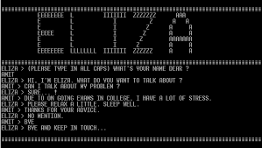
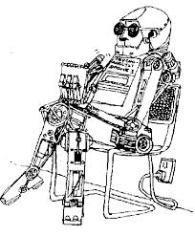
Towards this end
1966: Joseph Weizenbaum developed Eliza a Rogerian psychotherapist

Slide 35
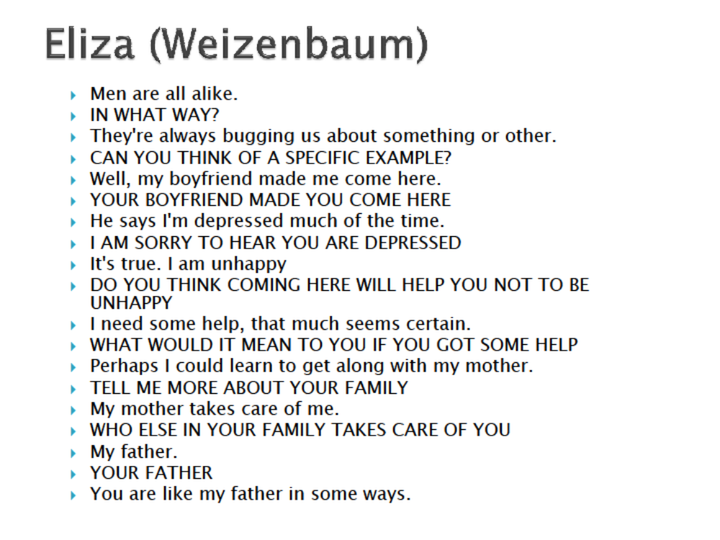

Slide 36
Eliza
Simple program that uses pattern matching to process the input and translate it into suitable outputs.
Succeeded because Eliza didn’t need to know anything in order to simulate a Rogerian psychotherapist.
    Rogerian psychotherapy is a form of talk-psychotherapy that is person centered.
  Weizenbaum notes: this is one of the few dialogue genres where listeners can act as if they know nothing of the world.
Amazing thing: people believed that ELIZA understood them and their problems

Slide 37
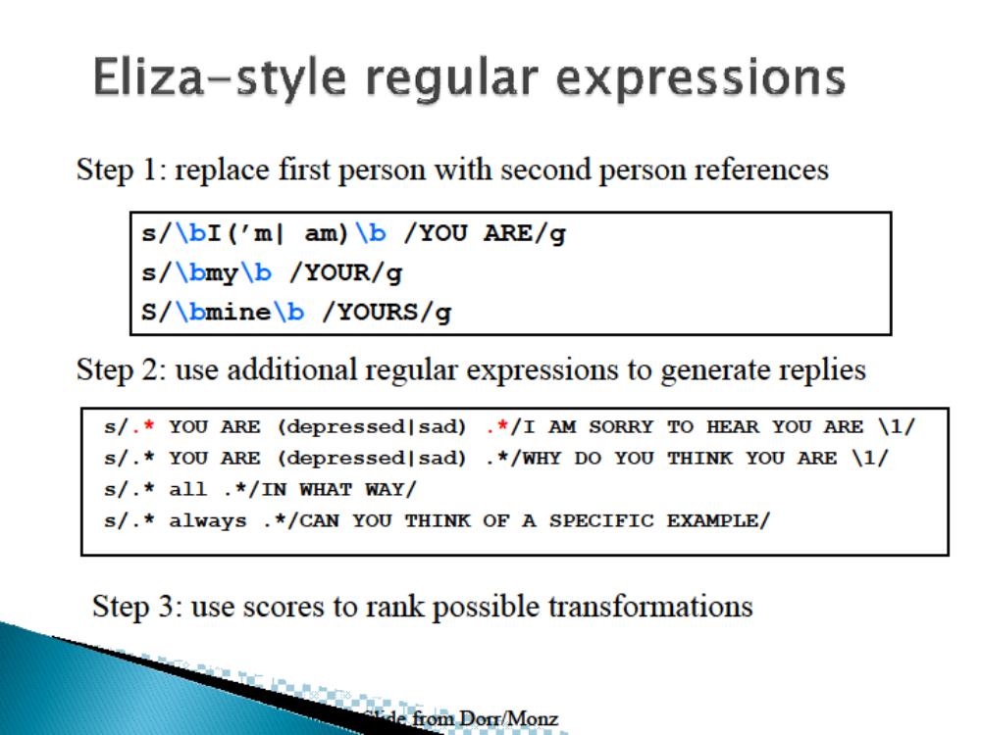

Slide 38
How far does this all you to go?
How much of a Q&A system is this?
Advantages?
Disadvantages?
    We will find out in our first programming assignment!

Slide 39



Next up
Rest of this class:
  Programming Assignment #1
This week:
  Wednesday’s class: Perl (includes more regexes) plus assign Wilks’
  Friday’s class: More Perl (includes more regexes)
Next week :
  Monday: Discussion on Turing’s paper
    Don’t panic: you still have a week to review it and it will be longest paper
    The latex example is up on the Blackboard
  Wednesday: Lecture on Formal Languages
  Friday: Discussion on Wilks’

